Slide 1
The Romantic Movement (1750-1870)
AP English Lit. & Comp.

Slide 2
Romantic Movement
A revolutionary movement (1750-1870) that brought great changes to literature and society.
Emphasized:
Emotion
Imagination
Rebellion against social conventions
WHY? Reaction to the emphasis on “rational thought” of the Enlightenment.
Favored subjectivity & freedom over logic, objectivity, and social restriction

Slide 3
Influences on Romantic Movement
Society, politics, and culture in were forever changed by the American and French Revolutions.
French Revolution – rejection of monarchy in favor of democracy. Motto was “Liberty, Equality, Fraternity” which became important concepts for Romantic writers in both Britain and the US.

Slide 4
Key Concepts of Romanticism:
Freedom of the individual
Feeling and imagination over rational thought
Emphasis on common people
Interest in natural world and the supernatural

Slide 5
Romantic Philosophy (Freedom)
The desire to be free of convention and tyranny, with a focus on individual rights and human dignity.
Jean-Jacques Rousseau
Political philosopher
Novelist
Champion of freedom of the human spirit
Established “cult of the individual”

Slide 6
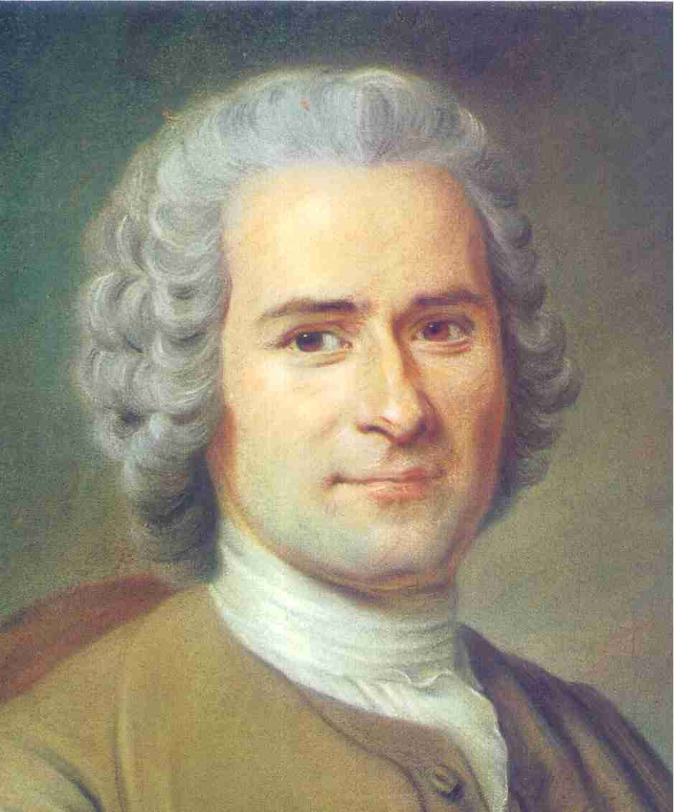
Romantic Philosophy
Rousseau
1755 – Discourse on the Origin of Inequality
1762 – The Social Contract
These works discussed
Rich vs. Poor
Innocence vs. Experience
Corrupting influence of society

Slide 7
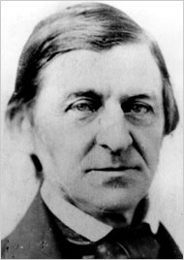
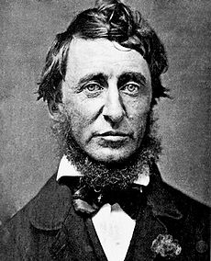
Romantic Philosophy
Transcendentalists
In America, the Transcendentalism Movement reflected the Romantic interest in both the individual and nature.
Emerson
&
Thoreau

Slide 8
Romantic Philosophy
Transcendentalists
Emerson – stressed the imaginative power of the mind over social constraints.
Was controversial because he attacked organized religion and materialistic values.
Published The American Scholar and Self-Reliance
Emerson’s individualistic spirit has become central to America’s cultural identity.
Thoreau – shared Emerson’s ideas about self-reliance, individual freedom, and the natural world.
Published Walden in 1845
Published Civil Disobedience in 1849

Slide 9
Romantic Poetry
Emphasized the importance of feeling and imagination over reason.
Denounced traditional forms, subjects, and meters.

Slide 10
Romantic Poetry
Some poets represented freedom with
Exotic locations
Mystery
Supernatural Events
Others wrote poems that protested social wrongs or supported causes of liberty.

Slide 11
Romantic Poetry
Heroes were often common men
Idealized nature and rural life over urban life
Mourned the loss of rural life
Created a mood of melancholy in their poetry
This melancholic tone later became a theme in and of itself.

Slide 12
First Generation of British Romantics
William Blake
Most mystical of Romantic Poets
Songs of Innocence and Songs of Experience
Used form of popular songs and rhymes
Contrasted childhood innocence with social experience
Opposed the rationalism and materialism of his time
Became obsessed with imagination
(even created a religious mythology of his own!)

Slide 13
First Generation of British Romantics
William Wordsworth & Samuel Taylor Coleridge
Together published “Lyrical Ballads,” which:
Was essentially a Romantic Manifesto
Emphasized:
Imagination over reason
Emotion over logic
Love of nature
Respect for regular people

Slide 14
First Generation of British Romantics
Coleridge –
Explored the exotic and supernatural
Kubla Khan (1816)
Wordsworth –
Strong feelings about nature and childhood
Tintern Abbey, The Prelude, others…

Slide 15
2nd Generation of British Romantics
Percy Bysshe Shelley –
Involved in radical politics
Believed poetry could have great power because poets could imagine a more just world
Ode to Liberty
Wrote passionately about nature
To a Skylark

Slide 16
2nd Generation of British Romantics
John Keats –
Wrote famous and beautiful poetry that deals with the connection between nature and art.
Contrasts the eternal beauty of nature and art with the fleeting nature of human life…
Ode to a Nightingale, Ode to a Grecian Urn, more…

Slide 17
American Romantic Poets
Shaped a unique poetic tradition that drew on transcendental ideals and emphasized links between nature and freedom.
Rejected traditional form and subjects like the British Romantics.
However, was less melancholy and more hopeful about possibilities of life

Slide 18
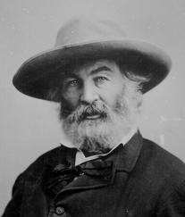
American Romantic Poets
Walt Whitman –
Leaves of Grass (1855)
Celebrates the individual and potential for human harmony with nature.
Song of Myself
Considered one of the most important pieces of American literature.
Influenced by Emerson
Power of the individual mind
Importance of democracy

Slide 19
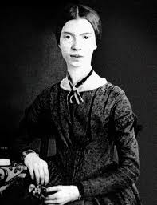
American Romantic Poets
Emily Dickinson
Wrote original, symbolic poetry
Poems filled with strong emotions and energy
Not considered a major figure of her time, but her experiments with symbolism and her expression of her inner life as a woman inspired generations of poets.

Slide 20
Romantic Fiction
Contained many of the same themes as Romantic philosophy and poetry.
Focused on freedom, nature, and regular people.
In addition, there was a focus on freedom of imagination, which led to the supernatural and exotic.
Many writes explored symbolic struggle of opposites, including:
Good vs. Evil
Individual vs. Society
Innocence vs. Experience

Slide 21
Romantic Fiction
Gothic Novel –
Among most popular types of novels at the time.
Dealt with supernatural, exotic events, and irrational characters.
Mary Shelley’s Frankenstein is a good example

Slide 22
Romantic Fiction
Edgar Allen Poe
American who wrote in the Gothic tradition
Explored the dark side of human experience
Herman Melville
Moby Dick
Struggle between good and evil
Individual’s struggle with forces beyond his control
Harriet Beecher Stowe
Uncle Tom’s Cabin
Romantic emphasis on freedom in account of slavery

Slide 23
Summary
Key Ideas:
The effect of the French and American revolution
Freedom of individual in relation to society and nature
Importance of feeling and imagination rather than rational thought
Rejection of classical style and content
Emphasis on common speech and common people
Interest in both the natural world and the supernatural

