Slide 1
Turn of the Century Literature
AP English Lit. & Comp.

Slide 2
Sense of Possibility
The turn of the century was a time when people turned their attention towards the future.
Keep in mind that there was a great sense of possibility. Artists, workers, social reformers, and even colonized peoples began to challenge the established order even more than they did in the Victorian era.

Slide 3
End of the Victorian Era
Marked by the death of Queen Victoria in 1901.
Change had already begun – people were beginning to reject Victorian values such as respectability, earnestness, and industriousness.
This shift in Britain was one toward conspicuous consumption and pleasure. The new king, Edward, was self-indulgent and promoted lavish spending by the upper class.

Slide 4
Shifting Values
This trend was also seen in America, where the wealthy were building ornate mansions in cities like New York and Chicago.
In this atmosphere of indulgence, inequities between the highest and lowest classes grew sharper.
Artists and intellectuals turned away from excess and began promoting less materialistic values, which alienated them from society and popular culture.

Slide 5
Alienation of Artists
Many artists and intellectuals frowned on what they called “yellow journalism,” which was a highly sensationalized style of journalism that the most average people loved.
This created a divide between popular culture and “high art” – what artists and critics considered “real” art.

Slide 6
Changes in Technology
Radio (1890)
Wireless Telegraph (1895)
Wright Brothers (1903)
Motion Pictures (1903)

Slide 7
“The more things change…”
Financial successes of the Victorian Era continued.
Electrical energy and industrial power fueled fast-paced economic development.
The “Captains of Industry” (like Rockefeller, Carnegie, Ford, & J.P. Morgan) amassed huge fortunes.
At the same time, unemployment, overproduction, and wage cutbacks continued to hurt the poor.

Slide 8
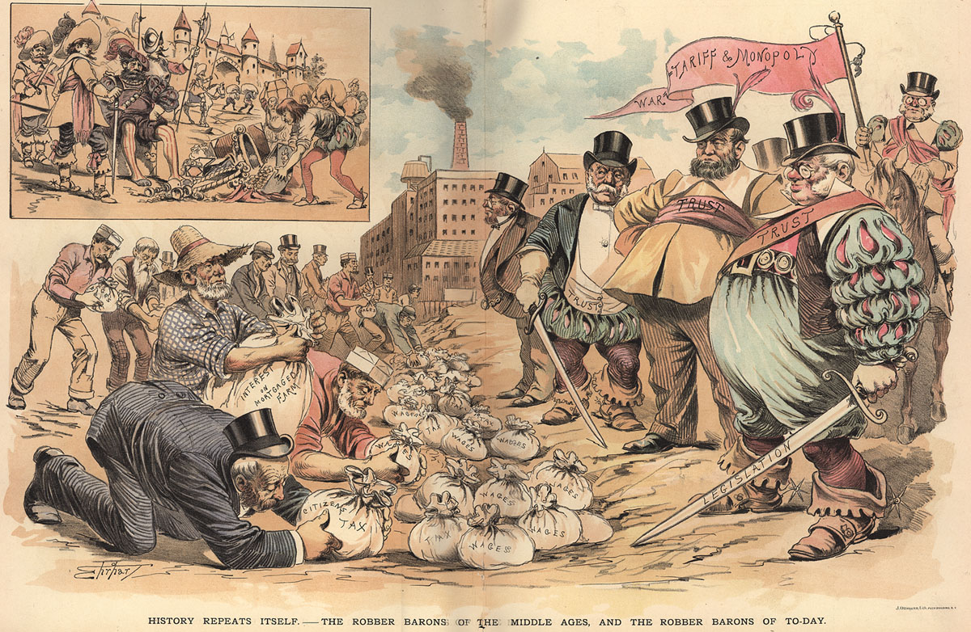

Slide 9
British Imperialism
The turn of the century was also a high point for British imperialism.
By 1894, Britain signed the Congo Treaty with King Leopold II of Belgium. This gave both countries colonies in Africa.
By 1900, the British Empire covered nearly twenty million square miles and contained three hundred million people.

Slide 10
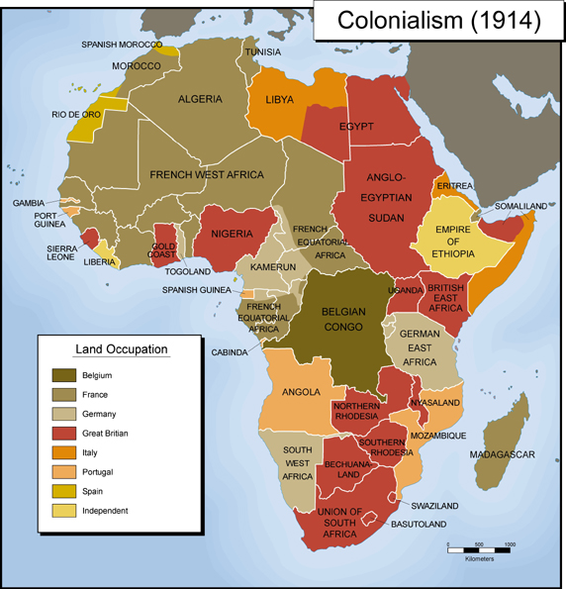

Slide 11
American Imperialism
In America, this was also a time of westward expansion and rising imperialism.
In 1912, the last states of the original forty-eight–New Mexico and Arizona–were admitted to the union.
The subjugation of Native Americans continued with this expansion. Many were killed, others were displaced. The U.S. government took land from all of them.

Slide 12
Imperialism
As America strengthened its hold on the American West, it also began exerting its influence over foreign countries.
European imperialism provided America with a model for foreign conquest. The Spanish American War led to the acquisition of America’s first colonies; Hawaii, Puerto Rico, the Philippines, and Cuba. (Alaska was already a “territory” at the time)
President William McKinley called this expansion and colonization the "manifest destiny" of America.

Slide 13
Women
Women made significant gains around the turn of the century. For example, married women gained some control over their property and children, and more and more women entered universities.
Women finally gained suffrage, the right to vote, in Britain in 1918, and in America in 1920.

Slide 14
But…
Hysteria – we’ll cover this a little later.

Slide 15
Art & Literature
Poetry – “Imagist” movement.
Encouraged by American Ezra Pound, this movement fought against the tradition of romantic, emotional poetry, and instead insisted on hard, clear, and precise images.
Fiction – “Naturalism”
Built off the evolutionary theory of Charles Darwin
Also suggested that individual character and fate were determined by heredity and environment.
Some implied that the poor were the weakest of the “species” and were not meant to survive.
More sympathetic writers emphasized the difficult conditions the poor faced.
Jacob Riis – “How the Other Half Lives”

Slide 16
Women in Literature
Many female writers argued that regardless of class, women were still dependent on men, and they blamed societal norms that portrayed women as expendable objects.
Rebecca Harding Davis – criticized treatment of mill workers
Mrs. Humphrey Ward – wrote about degrading conditions in London
Kate Chopin – focused her writing on the emotional and social position of women in the world

Slide 17
Joseph Conrad
Joseph Conrad is among the most well known of this generation of writers.
Born in Poland, he eventually became a British citizen, and then spent many years as a sailor in the British merchant service.
In 1890, he took a steamboat up up the Congo River. The experiences he recorded on his trip laid the foundation for his famous short story, "Heart of Darkness," published in 1902.

Slide 18
“Heart of Darkness”
"Heart of Darkness" is a critique of the European imperialist invasion of Africa.
In the story Conrad suggests that colonization was motivated by economic exploitation rather than the desire to bring civilization to so called savages.
This short story is a good example of the new techniques authors who were experimenting with at the turn of the century.
For example Conrad uses intermediate narrators and multiple points of view to suggest the complexity of human experience.

Slide 19
Charlotte Perkins Gilman
Charlotte Perkins Gilman was a key American writer during this time.
Gilman suffered from depression after the birth of her daughter, and was diagnosed with “hysteria.”

Slide 20
Hysteria
Victorian and turn of the century doctors frequently applied this diagnosis to women who didn't confirm to Victorianideals about feminine behavior.
In the late 19th and early 20th century, Dr. S. Weir Mitchell was the most prominent physician known for treating women with hysteria.
He claimed that women were prone to loosing their vitality through menstruation, pregnancy, and strangely, higher education. This caused them to become nervous, thin and unable to function normally.
He prescribed what was known as "the rest cure". Women were subjected to bed rest, seclusion, constant feeding, and enforced idleness. This treatment was supposed to heal women by re-centering them on what was considered more proper feminine behavior. But… many women became insane from this treatment which was really a form of sensory deprivation.

Slide 21
Back to Charlotte Perkins Gilman -
She was put on Dr. Mitchel famous "rest cure," and advised to have her daughter with her at all times.
This treatment only exacerbated her illness and she ended up leaving her husband and child.
She memorialized the maddening effects of this treatment in her well-known short story, "The Yellow Wallpaper," published in 1892.
Gilman became a leading feminist in America. She wrote both non-fiction and fiction on the subject of women's rights.

Slide 22
Notable Turn of the Century Writers -
Edith Wharton –
“House of Mirth” (Hypocritical treatment of women in wealthy New York society)
Henry James –
“Daisy Miller” (Differences between American and European culture)
E.M. Forster –
“A Passage to India” (Imperialism)

Slide 23
Summary
Rejection of Victorian values
Conspicuous consumption
Growing disparity between rich and poor
Growing imperialism in Britain and America
Changing role of women
In fiction, realism was succeeded by naturalism, and writers depicted the hardships facing the poor and women.
Writers, including Joseph Conrad and Charlotte Perkins Gilman, wrote complicated narratives that dealt with pressing social issues.

