Slide 1
The Modernist Period (1914-1939)
AP English Lit. & Comp.

Slide 2
Age of Anxiety
In some ways, the defining characteristic of the modern era is anxiety.
WWI
Economic Depression
Advances in Communication and Technology
Decline of British Empire
Political Instability in Europe

Slide 3
World War I – “The Great War”
The modern era began around 1914, the same year World War I began. The psychological impact of this war can't be overemphasized.
Advancements in war technology made the great war particularly horrific. The realities of trench warfare, poison gas, land mines, and machine guns left their imprint on soldiers.
World War I had the highest fatality rate of any war before or since.
Thousands of British and American soldiers returned home with shell shock, an anxiety disorder brought on by battle trauma. (We would call it PTSD now.)

Slide 4
Economic Depression
The Great Depression in the United States was part of a larger global economic downturn in the 1930s.
Many people lost their livelihoods, property, and homes.

Slide 5
Communication & Technology
Advances in communication and technology during this era contributed to the sense of a changing order.
The telephone, the radio, motion pictures, and the phonograph were becoming a part of people's daily life during this time.
Though these advances had many positive effects, they forever changed the ways people communicated with each other and how they thought about the world.

Slide 6
Decline of British Empire
The modern era also saw the beginning of the slow decline of the British empire.
In 1915, Britain's power was challenged in India by Mohandas Gandhi's independence movement.
Britain's hold over Ireland was also highly contested. The Easter Rising of 1916 was followed by intense warfare between Irish rebels and British forces. The Free Irish State was later established in 1921.
Egypt achieved independence in 1923.
The British Commonwealth later granted equal status to such nations as Canada, Australia, and New Zealand in 1931.

Slide 7
Political Instability in Europe
The declining of the British Empire was only one sign of the change that was sweeping across the world.
In 1917 the Bolsheviks overthrew the czar and established a communist government.
Also in Europe a lot of political ideas such as anarchism, socialism, and casteism were gaining wide spread acceptance.
Eventually the instability of the era would produce Fascist governments in Germany, Italy, Russia, and Spain.
At thatpoint, Europe was on the road to World War II.

Slide 8
So What?
Literature of the time captured the anxiety people were feeling as a result of the turmoil of the era

Slide 9
Social Anxiety in America
In America, there was a great deal of uneasiness about the country's relationship to the rest of the world.
Although World War I began in 1914, America's isolationist sentiments kept it out of the war until 1917.
Between 1820 and 1930, thirty-eight million new citizens arrived in America. Concerns about immigrants led the American government to severely restrict immigration. Quotas were imposed in 1924, limiting the number of south-eastern Europeans and Asians who could enter the country.
Americans directed hostility at both foreigners and immigrants.

Slide 10
Racial Anxiety in America
Racial anxiety went hand-in-hand with hostility toward foreigners and immigrants.
The growth of urban and industrial centers in the North brought millions of rural, Southern blacks into northern cities to find work. This was known as The Great Migration.
Because of poor living conditions, and underemployment, these cities became sites of racial tension.
The Ku Klux Klan, a violent racist group founded in 1915, gained strength in the twenties and thirties as racial tensions mounted.

Slide 11
The Role of Women
Anxiety about the role of women also permeated both Britain and America.
Women became a greater force when they gained the right to vote.
The social disruption of World War I encouraged women to enter the workforce in much larger numbers than ever before. They enjoyed a wider range of occupations, including teaching, clerical work, and sales. Some women even worked as nurses or ambulance drivers during the war.

Slide 12
Intellectual Anxiety
Both countries also experienced intellectual anxiety as traditional beliefs were challenged.
Sigmund Freud's important work in psychoanalysis explored the notion of unconscious thoughts. His model of the mind as a set of complex layers shaped by external forces challenged traditional notions about free will.
Scientific thinking also cast doubt on ideas that previously seemed absolute. Einstein's theory of relativity suggested that our previous understandings of space and time were inaccurate.
Philosophers such as Freidrich Nietzsche questioned our ability to know or understand our world.

Slide 13
Art & Literature
The breakdown of social order was reflected in the art of the modern period.
At the center of the modernist aesthetic was the notion that the earlier structures of human life had either been demolished or shown to be false.
Modernists believed that art had incorporated a false sense of unity that didn't reflect reality.

Slide 14
Art
British and American artists were influenced by Impressionist, Postimpressionist, and Cubist painters to question the nature of reality.
Painters such as Renoir and Picasso used techniques of Impressionism and Cubism to break down traditional modes of representing the world.
They substituted abstract forms for realistic pictures.

Slide 15
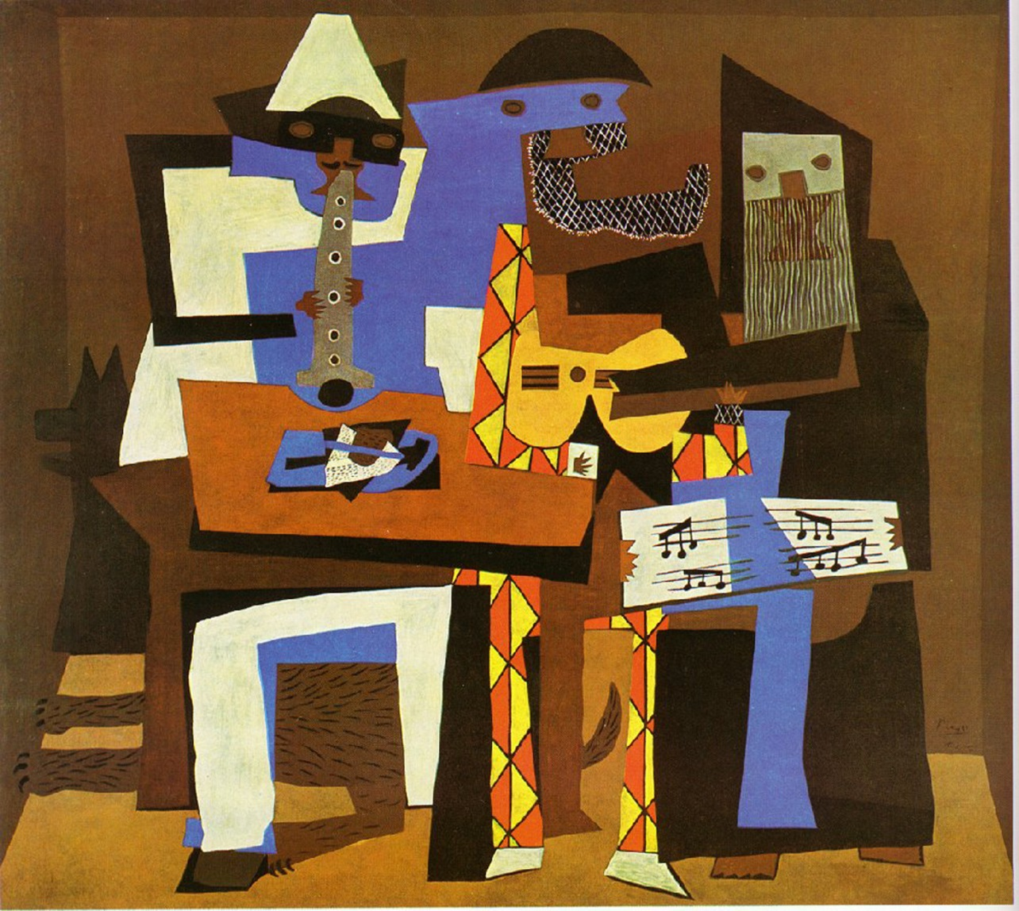
Picasso
“Three Musicians”

Slide 16
Art
Modernists believe that for their work to mimic reality, it had to reflect the fragmentation of experience.
Whether a novel, a painting or a piece of music, its construction was pieced together from fragments.
Longer pieces were made up of a collage of fragments, shorter works could be individual fragments in and of themselves.

Slide 17
Modernist Literature
Unlike Victorian and turn-of-the century literature, modern writers cut out unnecessary details.
They omitted introductions, explanations, interpretations, summaries, and continuity.
Most modernist literature begins arbitrarily and ends without closure or resolution.
It's made up of various shifts in perspective, voice, and tone.
The reader must take an active role in creating the meaning.

Slide 18
Modernist Literature
The Modern era offers us the development of the stream of consciousness novel.
This type of work focused on the mental processes of a single central character hearing her thoughts, responses, and interior emotional experiences. Words mimic the flow of human thoughts.
James Joyce's novel Ulysses (1922)
Virginia Woolf's Mrs. Dalloway (1925)

Slide 19
Modernist Short Stories
Modern short stories moved from the turn-of-the-century depiction of complex social webs to depictions of short, eventful moments in time.
James Joyce called these type of moments epiphanies or revelations. They functioned as turning points in the character's life.
(Think back to “Araby” by Joyce)

Slide 20
Modernist Poetry
Modernist poetry was influenced by the turn-of-the-century Imagist movement, which insisted on hard, clear, poetic images.
However, modernist poets began rejecting traditional rhyme and rhythm conventions in favor of free verse. Free verse was meant to capture the rhythms of everyday speech.
Like fiction, longer poems were made up of a collection of fragments.
Modernist poetry has a tendency to incorporate numerous allusions to myths and quotations from a wide range of languages and traditions. This can make modernist poetry quite difficult to read and understand.

Slide 21
Examples
T.S. Eliot – probably the most well-known American modernist poet. Wrote poems composed of fragments of literary and historical allusions and remnants from everyday life.
“The Waste Land”
“Hollow Men”
“The Love Song of J. Alfred Prufrock”
Defining poet of fragmentation and disillusionment. (Often called “existentialism.”)

Slide 22
Examples
William Carlos Williams is another American modernist poet well known for his disagreements with other modernists.
He used simple verse forms and mundane subject matter in an attempt to mimic everyday American speech.
Using his career as a doctor to support his poetry writing, Williams refused to make general statements about the decline of civilization.
His poetry presented details of American life, mostly without comment, and used objects to represent ideas.
He published several works of fiction, essays, and poetry.

Slide 23
Examples
Virginia Woolf is one of the best known British modernist authors.
In 1917, she and her husband founded the Hogarth Press which published an early volume of T.S. Eliot's poems, as well as her own novels.
Woolf is known for the stream of consciousness style of her most famous novels, Mrs. Dalloway, published in 1925, and To the Lighthouse, published in 1927.
She was also a leading feminist. In her work A Room of One's Own, published in 1929, and Three Guineas, published in 1938, Woolf first explored the status of women in modern society.

Slide 24
Summary
We have looked at the breakdown of society that characterized the modernist period, which lasted from roughly 1914 to 1939.
When you read modernist literature, it's important to understand how anxiety over societal changes influenced modernist art and society.

Slide 25
Age of Anxiety Review
Post-World War I disillusionment in the 1920s – idea of senselessness and anxiety that characterized the modern age.
Simultaneous rapid advancements in communications and technology contributed to the sense of a swiftly changing order.
People experienced uneasiness about their relationship to the rest of the world.
Decline of the British Empire
American Isolationism and social/racial anxiety
Changing role of women
Intellectual anxiety

Slide 26
Art & Literature Review
Fragmentation - Whether it was a novel, painting, or piece of music, art was pieced together from fragments.
Modern novelists developed the stream of consciousness narrative technique, and short stories revolved around epiphanies.
Poets built off the Imagist movement and rejected traditional rhyme and rhythm in favor of free verse.

